Slide 1

HACK BMU 7.0 HACKATHON
Project Name: Jeevan Marg
(Where Protection Begins and Fear Ends)
Team Name: Team Faith
Team Members:
Divyakant Mishra(Team Leader)
Vivek Shrivas (Team Member)
Manish Raj (Team Member)
Surjeet Karan (Team Member)

Slide 2
During natural disasters, affected individuals often face difficulty finding nearby shelters with available space. The absence of a centralized, real-time platform leads to confusion, delays, and overcrowded shelters. There's a critical need for a system that helps people locate and book safe shelters quickly, while allowing shelter admins to manage availability and bookings efficiently.
Problem Statement

Slide 3
•Jeevan Marg is a disaster relief web platform that helps people quickly find and book the nearest available shelters in times of crisis. It uses real-time location and availability data to guide users to safety, while allowing shelter owners to list, update, and manage shelters and bookings efficiently through an admin dashboard.
Introduction

Slide 4
Real-Time Shelter Availability Users can instantly view updated bed availability, ensuring faster and more reliable shelter access during emergencies. Location-Based Shelter Discovery The platform uses the user’s location to suggest the closest shelters, reducing travel time and improving safety. Efficient Shelter Management for Admins Shelter owners can easily list shelters, manage bookings, and update bed availability in real time, streamlining relief operations.
Proposed Solution

Slide 5
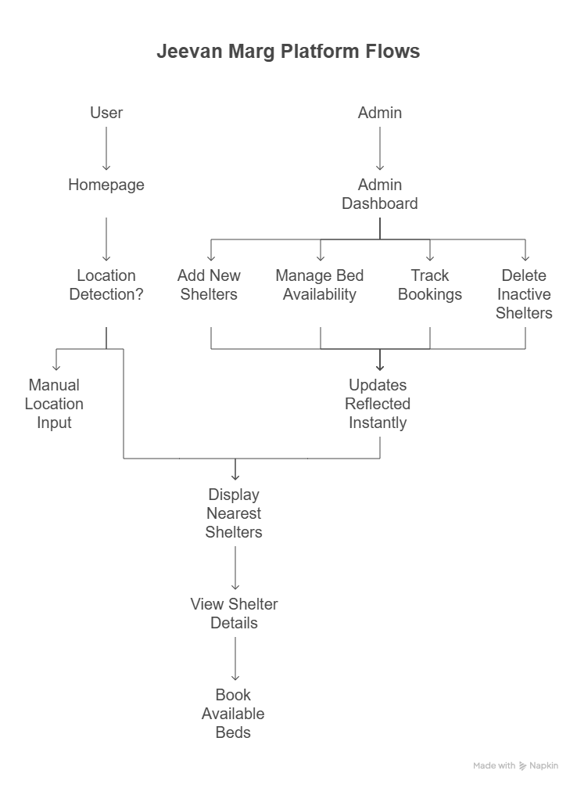
Flowchart

Slide 6
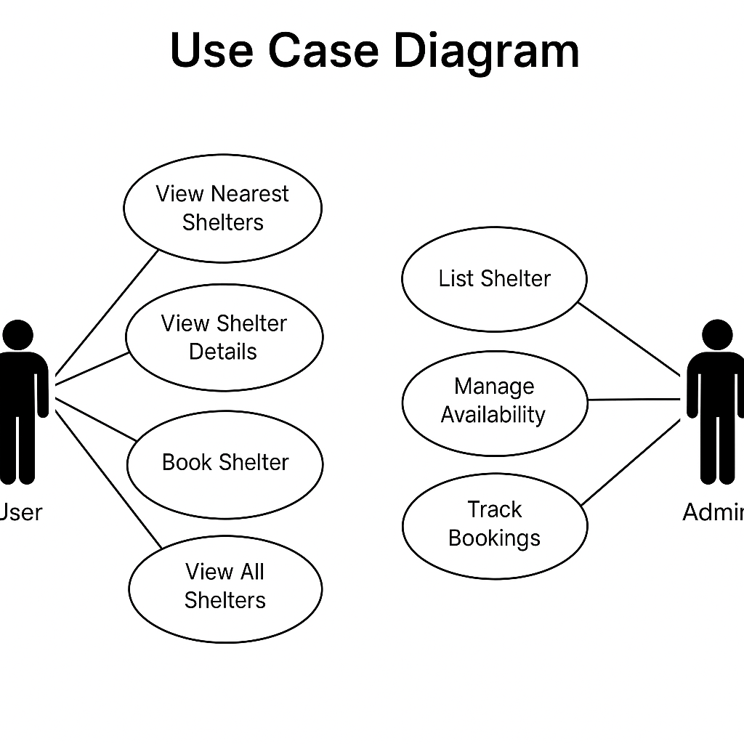
Use Case Diagram

Slide 7


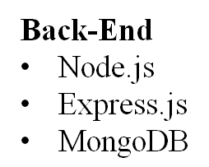


Front-End
• HTML
• Tailwind CSS
• React.js
Technology Stack
Authentication & Security
• JWT (JSON Web Token)
• bcrypt.js
Storage & multilingual Cloudinary React’s i18 library

Slide 8
Jeevan Marg is more than just a shelter locator — it’s a lifesaving platform designed for urgent, real-world needs. By connecting people to nearby shelters with real-time data and empowering admins with effective management tools, it ensures faster, safer, and smarter disaster response.
In times of crisis, Jeevan Marg becomes the digital path to safety.
Conclusion

Slide 9


